Slide 1
Teach me to help
Module I, Lesson 1: Definition of communication concepts, forms and types of communication
Project no: 2022-1-RO01-KA220-VET-000085029

Slide 2
01
Introduction to communication
Definition, importance and communication process

Slide 3
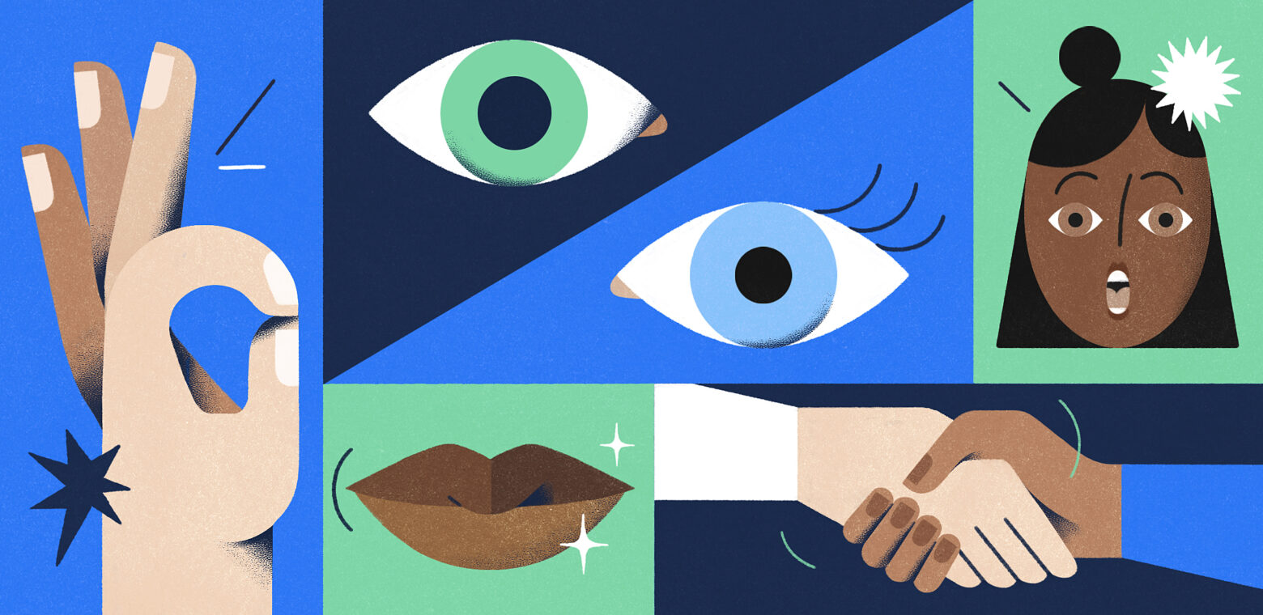
Definition of communication
Communication is the process of sharing information, ideas, emotions, and skills through the use of symbols, words, sounds, or behaviors. It involves a sender, who encodes and transmits the message, and a receiver, who decodes and interprets the message. This process can occur in various forms such as verbal, non-verbal, written, and visual.

Slide 4
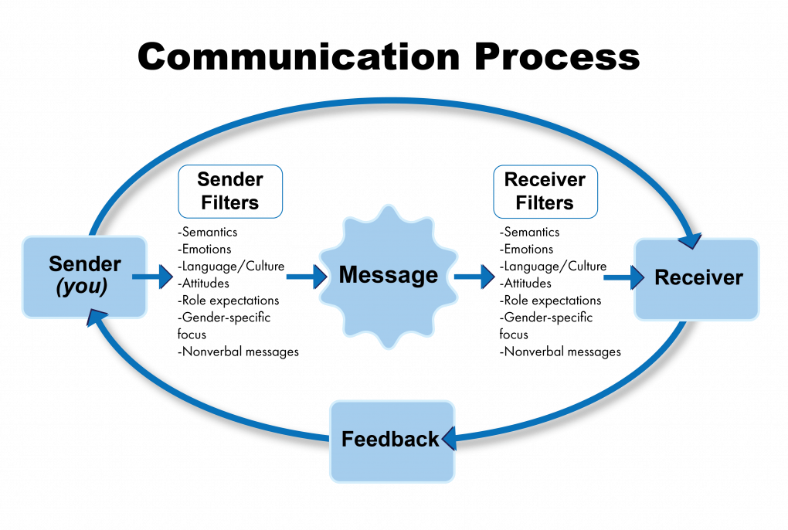
The communication process
Is a dynamic interaction involving several key components:
Sender - creates the message
Message - information, ideas, thoughts shared by the sender
Medium or channel - means through which the message is transmitted
Receiver - individual to whom the message is directed
Feedback - response from the receiver back to the sender

Slide 5
02
Types and forms of communication
Types, forms and barriers

Slide 6
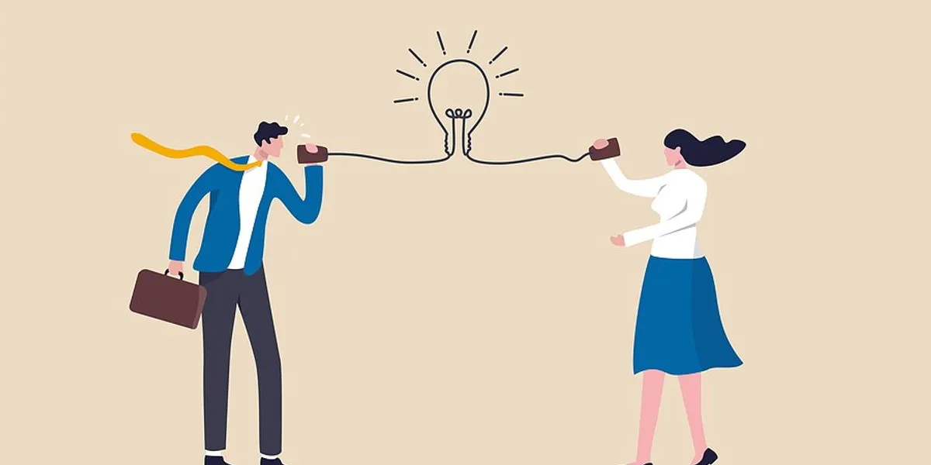
Types of communication
Verbal communication is the use of spoken or written words
Oral communication - face to face conversations, phone calls, video conferences, presentations
Written communication - emails, letters, reports, memos, social media posts

Slide 7
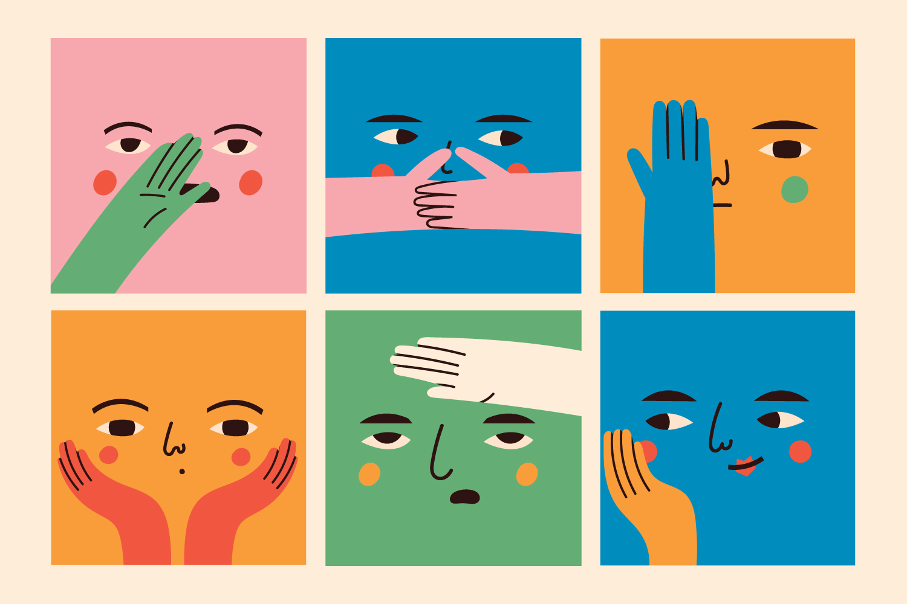
Types of communication
Non verbal communication: use of body language, gestures, facial expressions, eye contact, posture, other physical behaviors to deliver messages
The most known non-verbal ways of communicate are kinesics, proxemics, haptics, chronemics, paralanguage (which is the tone, pitch and volume of one’s voice).

Slide 8
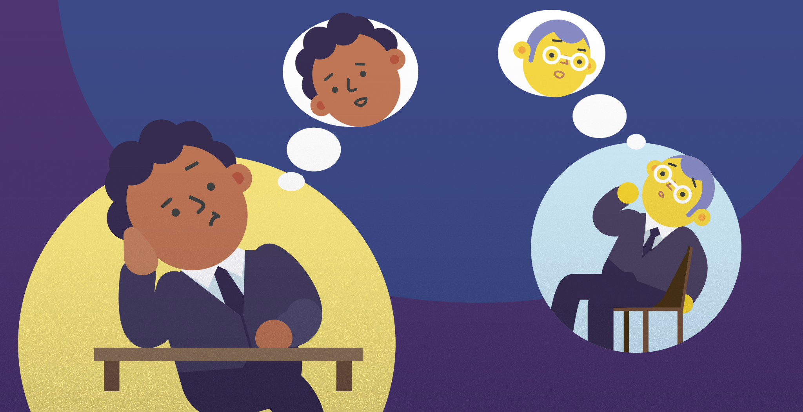
Forms of communication
Communication can take four forms: intrapersonal, interpersonal, public and mass communication.
Intrapersonal communication
thoughts , self-talk, internal reflections
Interpersonal communication
Direct, face to face between two or more people

Slide 9
Forms of communication
Public communication
When a person speaks to a large audience - public speaking, university lectures, or media broadcasts
Mass communication
Dissemination of information to a widespread audience, through mass media (TV, radio, newspaper, internet)

Slide 10
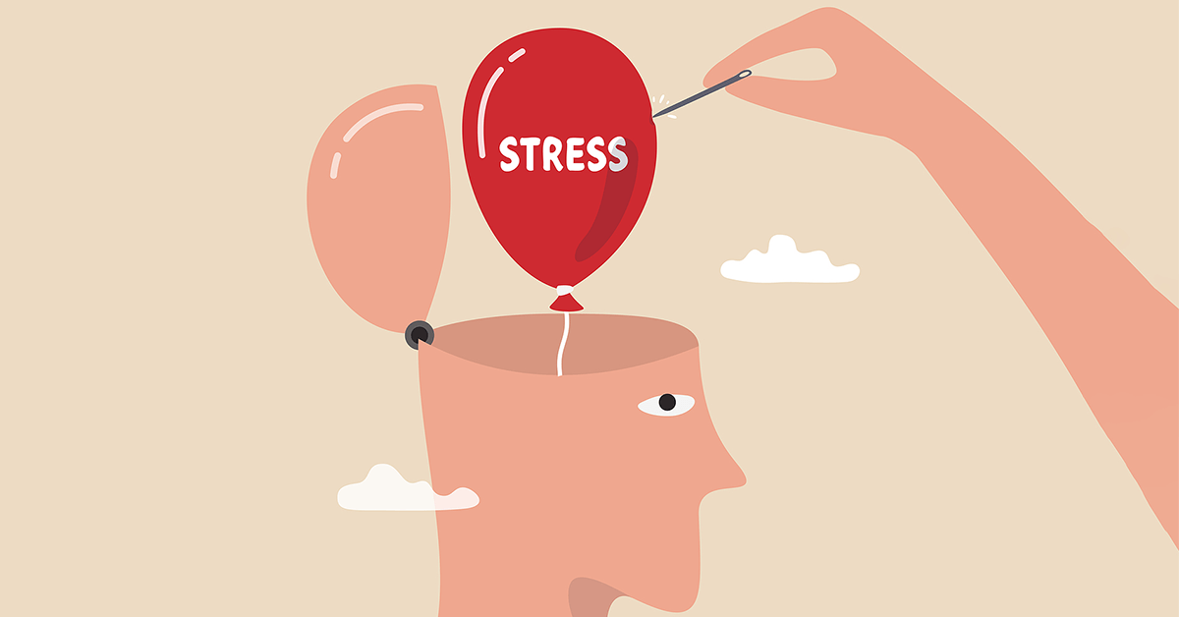
Barriers to effective communication
Barriers to effective communication are obstacles or challenges that hinder the successful exchange of information, ideas, emotions, or skills between individuals or groups. These barriers can manifest in various forms and arise from different sources, impeding the clarity, understanding, and effectiveness of communication.

Slide 11
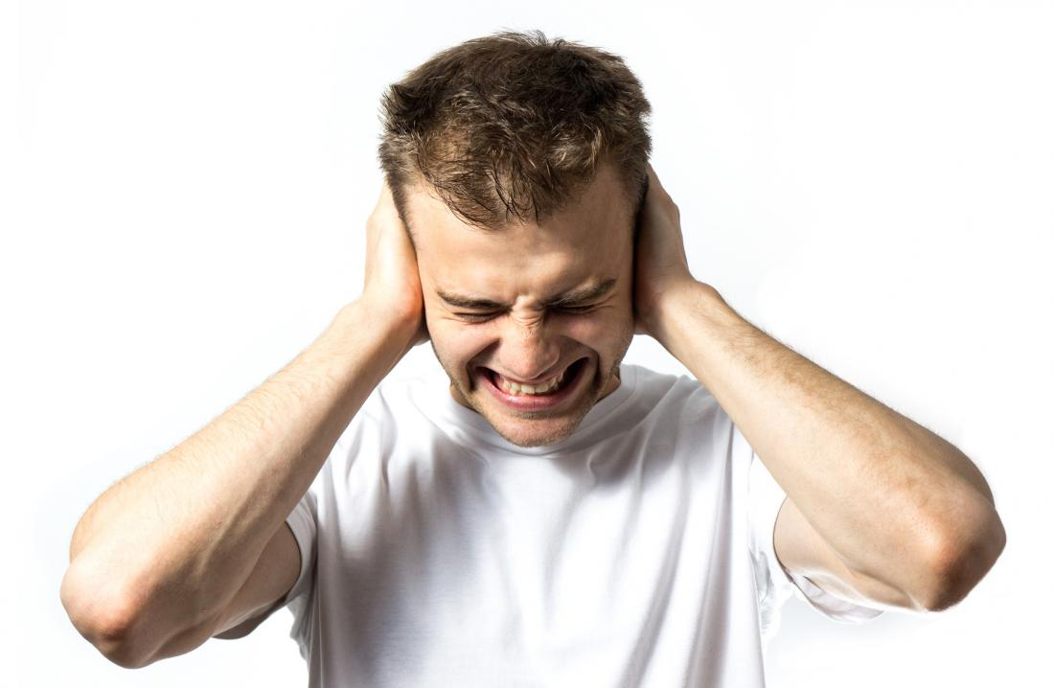
Barriers to effective communication
Physical barriers
Noise
Distance
Poor lightning
Technical issues
Psychological barriers
Stress
Emotions
Mental health
Lack of empathy

Slide 12
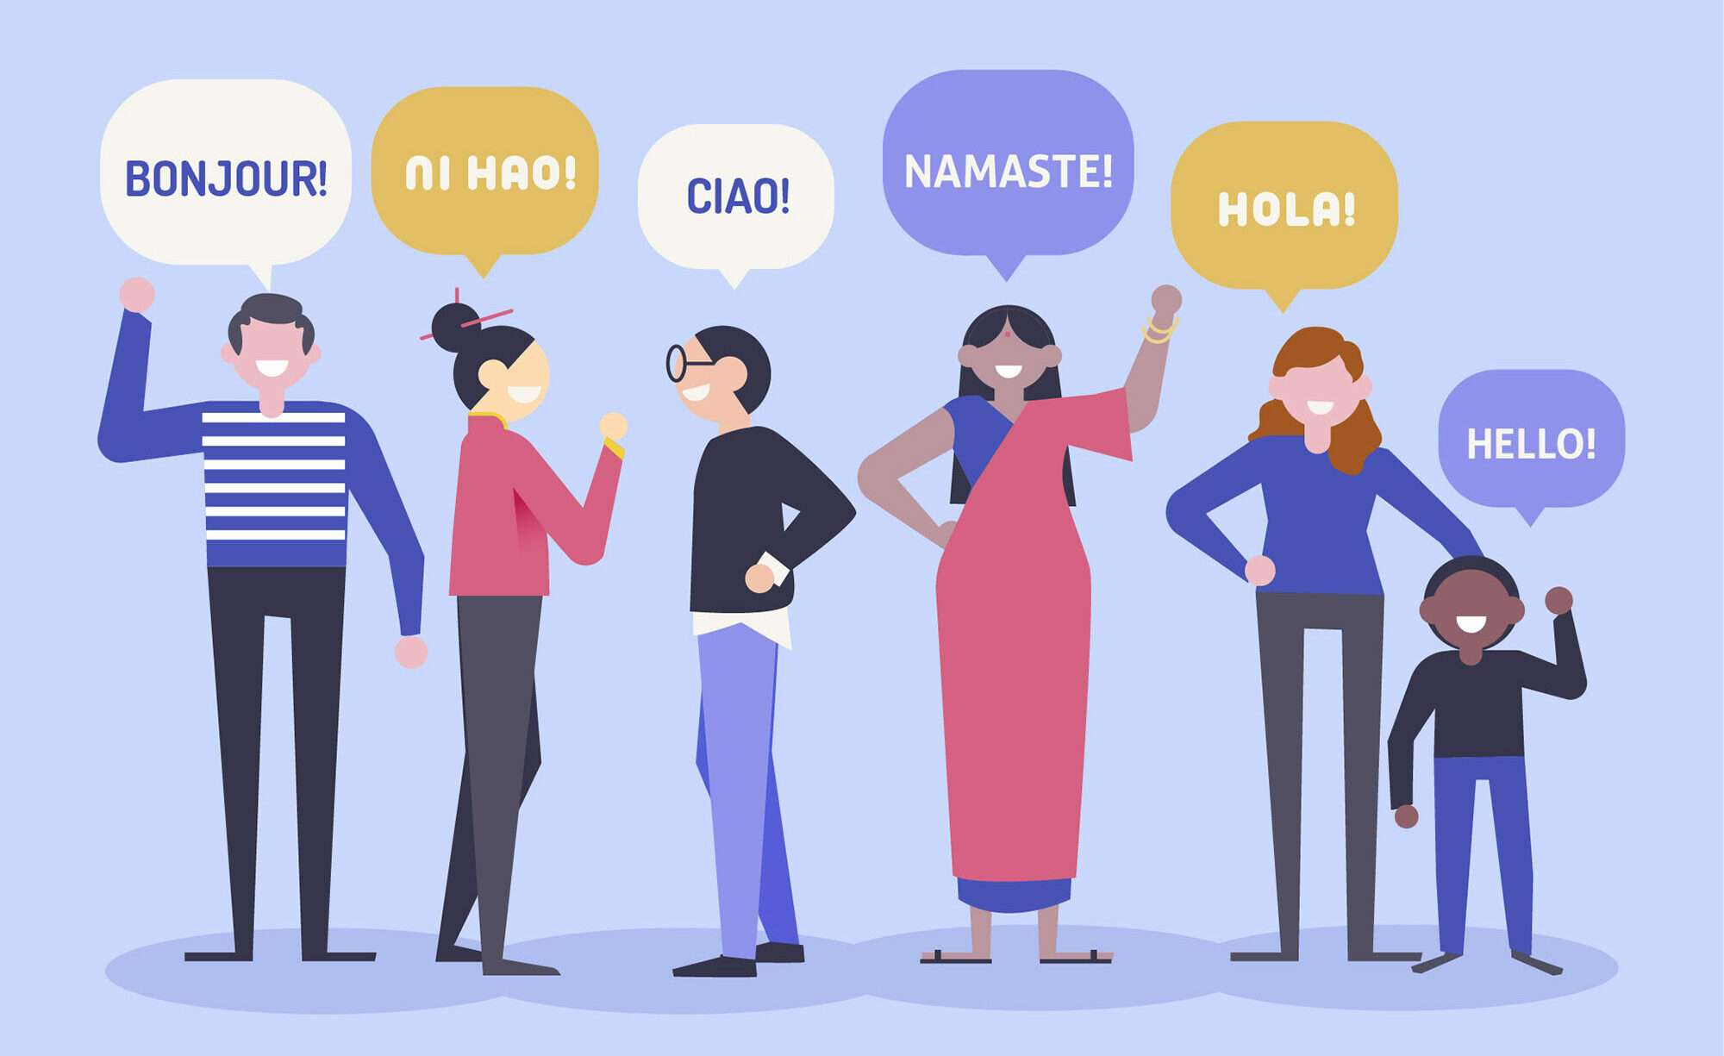
Barriers to effective communication
Language barriers
Not sharing common language, or different levels of proficiency in a shared language. Jargon, technical language, or complex terminology can create barriers for individuals who are not familiar with specialized vocabulary.
Cultural barriers
Differences in values, norms, beliefs, communication styles, social customs

Slide 13
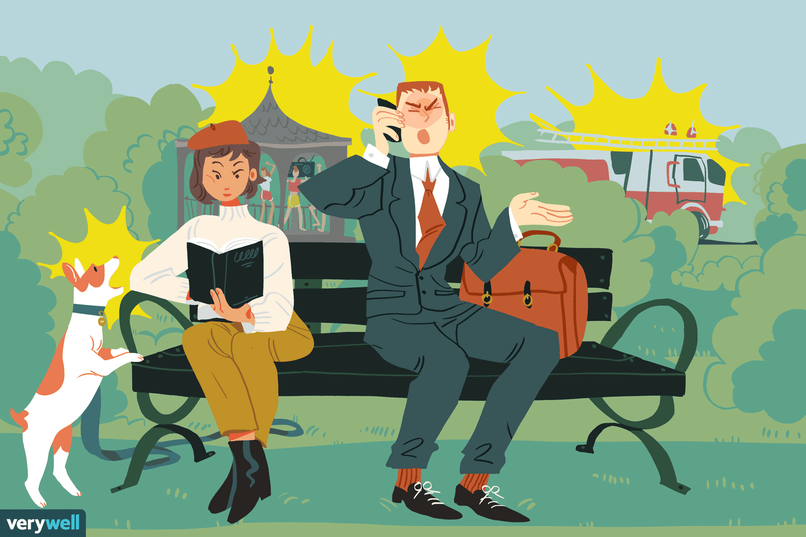
Barriers to effective communication
Perceptual barriers arise from differences in how individuals perceive and interpret information
Differences in sensory perception, cognitive processing and biases, or selective attention

Slide 14
To address these barriers, it is essential to consider the specific challenges faced by individuals with disabilities. For example, providing alternative formats for communication materials (e.g., Braille, large print, audio recordings) can help overcome physical and perceptual barriers. Fostering an inclusive environment that values diversity and respects individual differences can help reduce psychological and cultural barriers, promoting clearer and more effective communication.

Slide 15
03
Inclusive communication
Principles and impacts, challenges, stereotypes and engagement

Slide 16
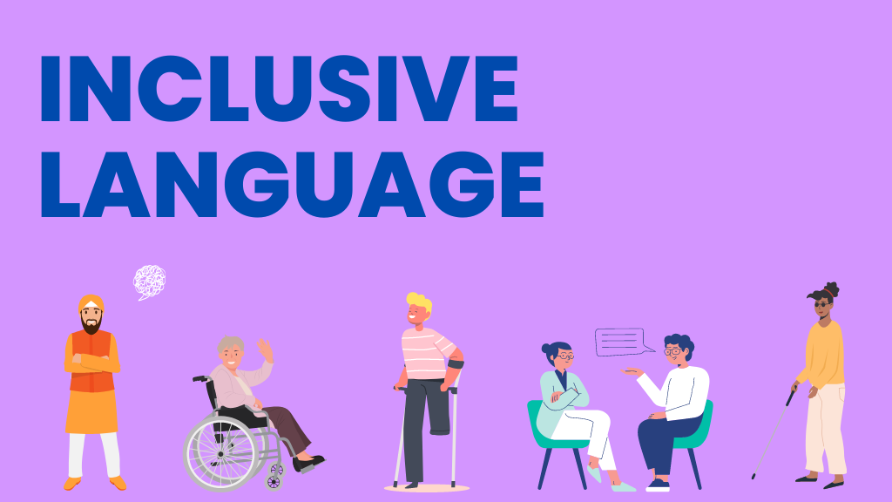
Principles
Person-First language: is putting the person before their condition. Say "person with a disability" rather than "disabled person."
Avoiding negative or diminishing terms
Using specific and accurate terms: When describing a disability, it's preferable to use specific and accurate terms. Say "person with cerebral palsy" rather than "person with motor issues." This helps avoid generalizations and inaccuracies.
Respecting individual preferences: It's important to respect how people with disabilities prefer to be referred to.

Slide 17
Impacts
Cultural and Social: The adoption of inclusive language can lead to positive changes in the perception of people with disabilities within society. It promotes acceptance and reduces the stigma associated with disability
Psychological and Emotional: Using inclusive language can improve the psychological and emotional well-being of people with disabilities. Feeling respected and recognized as full individuals can boost self-esteem and a sense of belonging.
Political and Legal: Inclusive language can influence policies and laws. Respectful and accurate language in legal documents and public policies can promote equality and the rights of people with disabilities. This is reflected in anti-discrimination laws and accessibility policies.

Slide 18
Examples and challenges
In daily life, using inclusive language means being mindful of the words we choose and how we use them. For example, instead of saying "mentally retarded," one should say "person with an intellectual disability."
Media plays a significant role in shaping public perceptions. Using inclusive language in media and advertising can help normalize diversity and promote a more inclusive view of society. For instance, representing people with disabilities in positive and varied roles rather than stereotyped ones.

Slide 19
Examples and challenges
Schools and universities should teach and promote the use of inclusive language to help shape a generation of more aware and respectful individuals. This can be done through awareness and inclusion programs.
Despite the clear benefits of inclusive language, challenges and resistance still exist. Some people may be reluctant to change their language for various reasons, including lack of awareness, habit, or disagreement with the concept of inclusive language. It's essential to address these resistances with patience and education, explaining the importance of respectful and inclusive language.

Slide 20
Avoiding stereotypes
Stereotypes about disabilities can be harmful and perpetuate misconceptions. One effective approach to avoiding stereotypes is using person-first language, which places the individual before their disability, emphasizing their humanity. For example, saying "person with a disability" rather than "disabled person" recognizes that disability is just one aspect of a person's identity.

Slide 21
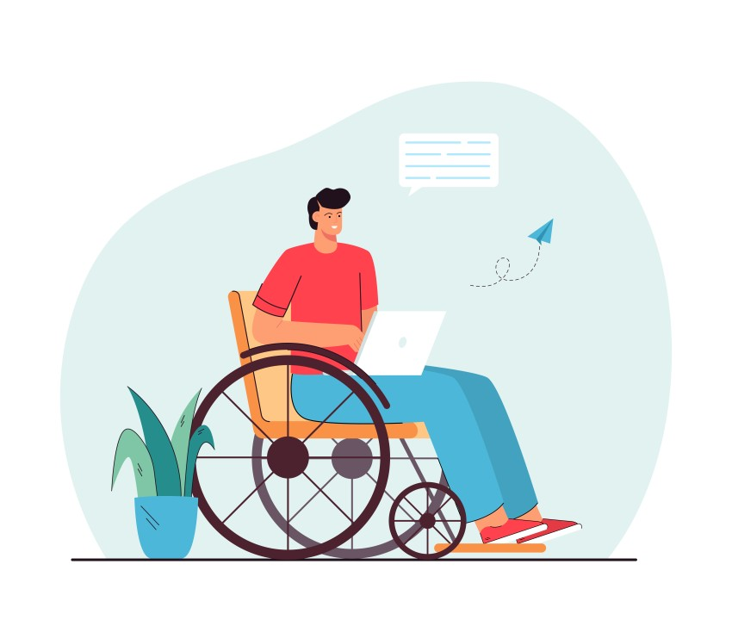
Avoiding stereotypes
Asking individuals about their preferences and needs rather than making assumptions fosters respectful communication. Steering clear of language that evokes pity or portrays individuals with disabilities as helpless is essential. Instead, using empowering language that respects their abilities and contributions promotes a positive image. For instance, rather than saying "suffers from," it is more respectful to say "lives with" or "has."

Slide 22
Engaging people with disabilities to communicate
Effective engagement involves actively including people with disabilities in conversations and decision-making processes. One way to enhance engagement is by creating accessible content. This includes providing captions for videos, using alt text for images, and ensuring that documents are compatible with screen readers, allowing people with disabilities to participate fully.

Slide 23
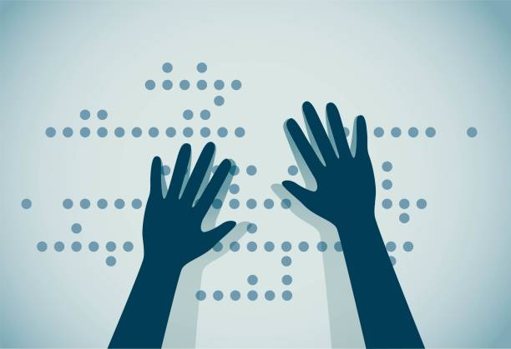
Engaging people with disabilities to communicate
Providing information in various formats caters to different needs. This might include printed materials, audio recordings, Braille, and digital formats accessible on different devices. Promoting inclusive participation involves encouraging people with disabilities to take part in discussions, meetings, and events, ensuring that venues are physically accessible and accommodations such as sign language interpreters or assistive listening devices are available.

Slide 24
Engaging people with disabilities to communicate
Fostering a culture of respect that values diversity and inclusion encourages open dialogue about disabilities and provides platforms for people with disabilities to share their experiences and perspectives. Using inclusive imagery in marketing materials, websites, and social media ensures that diversity, including people with disabilities, is reflected. Representation matters, and seeing diverse images helps normalize the presence of people with disabilities in all aspects of life.

Slide 25
04
Models and theories of communication
Chomsky, Piaget

Slide 26
Chomsky’s LAD
Theoretical construct proposed by Chomsky in the 1960s to explain the innate biological ability of humans to acquire language
Language Acquisition Device is a pre-wired neurological system in the brain that allows children to rapidly learn and understand language during their critical developmental periods

Slide 27
Chomsky’s LAD
Theory’s key points include:
Innate Ability: children are born with an inherent capacity for language acquisition, which is triggered by exposure to spoken language.
Universal Grammar: Chomsky proposed the idea of a universal grammar, a set of structural rules common to all languages, which the LAD helps children to recognize and apply.
Critical Period: there is a critical period during early childhood when the LAD is most effective, after which language acquisition becomes significantly harder.

Slide 28
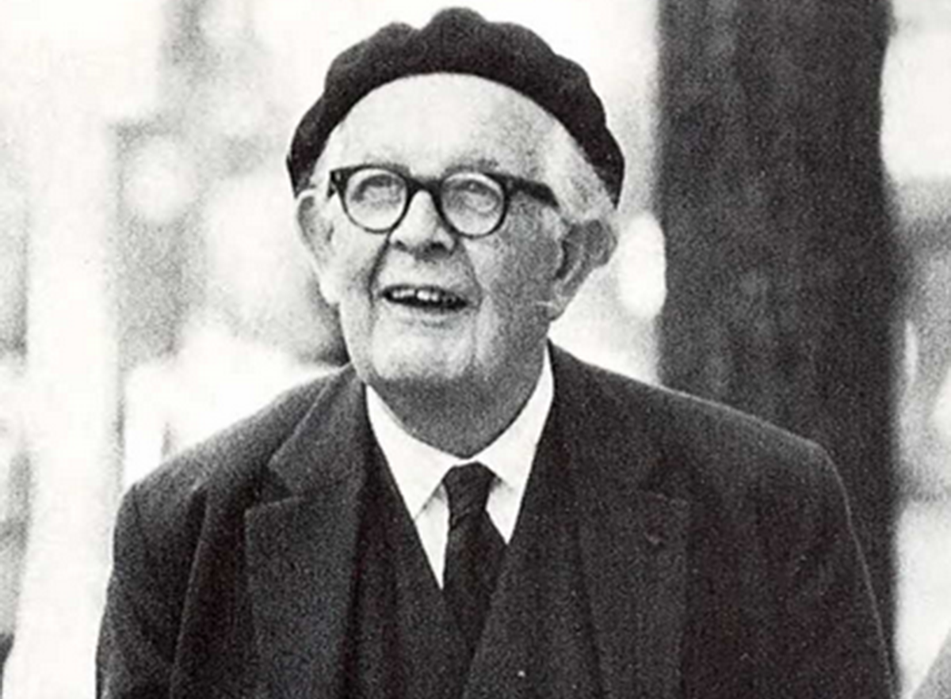
Piaget’s theory of cognitive development
Theory about the nature and development of human intelligence
The theory emphasizes the active role of children in constructing their understanding of the world through interaction with their environment
Cognitive development occurs through processes of assimilation and accommodation. As children progress through these stages, their capacity for understanding and using language becomes more sophisticated.

Slide 29
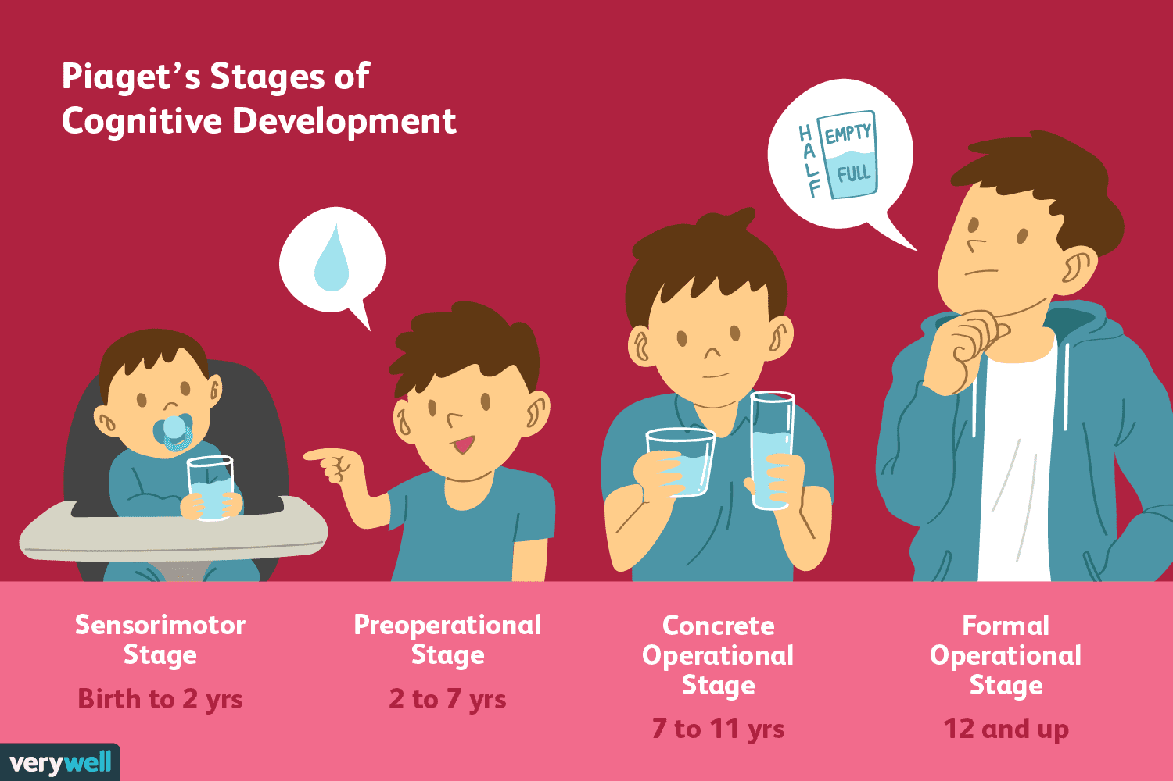
Piaget’s theory of cognitive development
Theory emphasizes the development of cognitive abilities as a foundation for effective communication
His theory is constructed around four stages of cognitive development:
Sensorimotor stage
Preoperational stage
Concrete operational stage
Formal operational stage

Slide 30
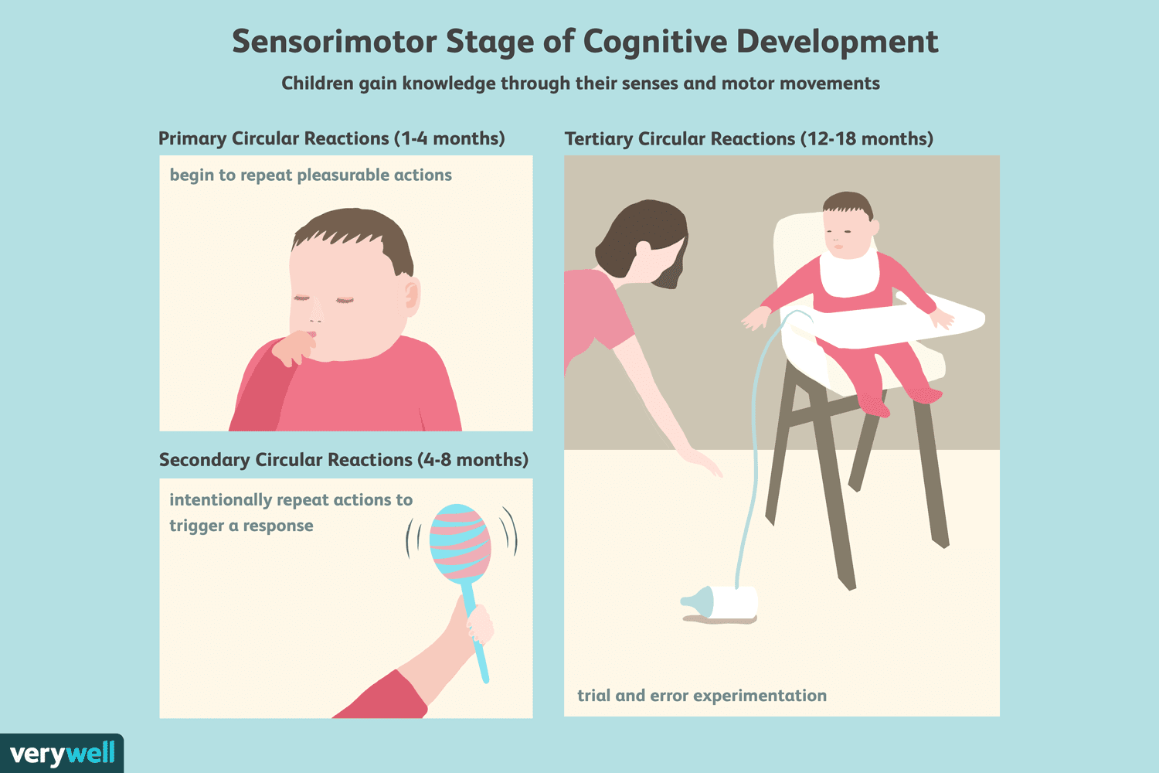
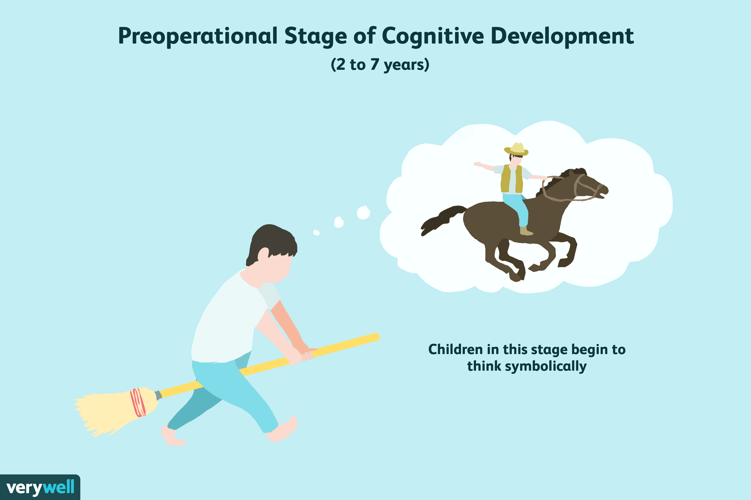
Piaget’s theory of cognitive development
Sensorimotor stage (birth to 2 years old)
Through senses and actions
Develop object permanence
Start to understand cause and effect relationships
Preoperational stage (2 to 7 years old)
More proficient with language and symbolic thought
Struggle with logic and understanding concrete reasoning
Often exhibit egocentrism

Slide 31
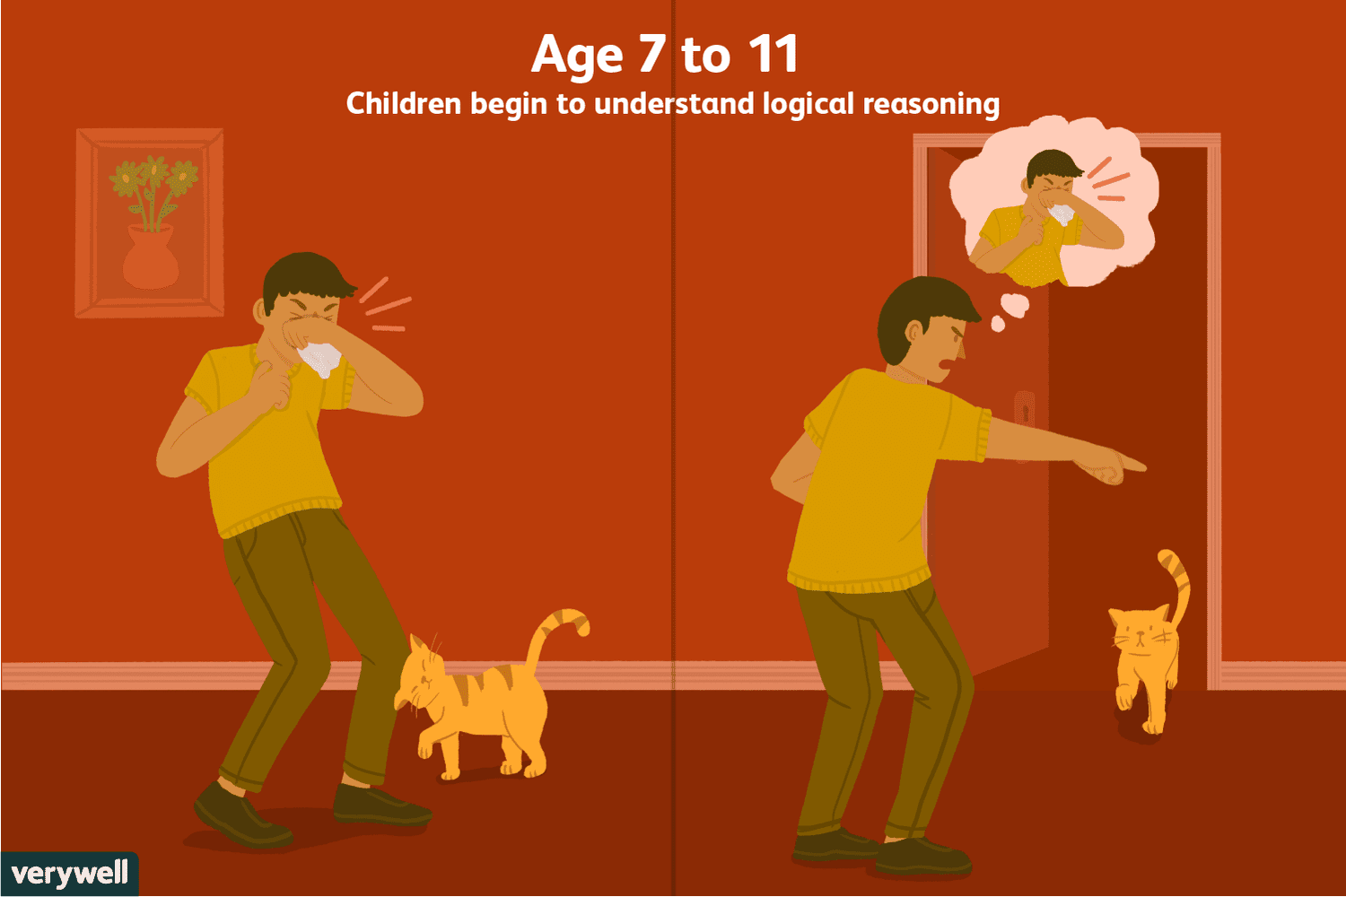
Piaget’s theory of cognitive development
Concrete operational stage (7 to 11 years old)
Logically thinking about concrete events
Understanding of conversations
Can perform simple logical operation
Formal operational stage (adolescence to adulthood)
Abstract thinking skills
Logically thinking about abstract concepts, formulating hypotheses, engaging in deductive reasoning

Slide 32
05
Neurological, developmental and psychological disorders
Neurological disorders, developmental disorders and psychological factors affecting communication, hearing and speech impairments

Slide 33
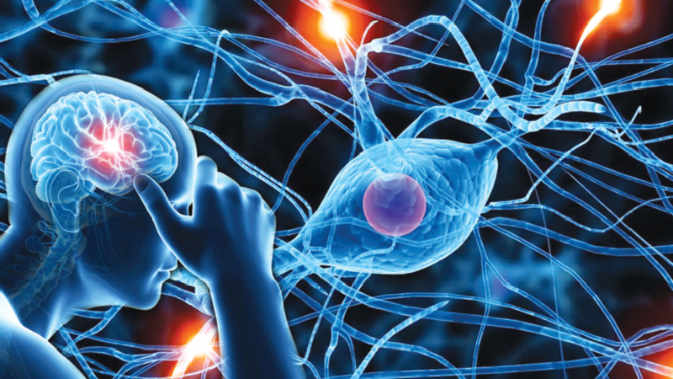
Neurological disorders affecting communication
Neurological disorders can significantly impact communication abilities by affecting various aspects of:
Language
Speech
Cognitive function
Neurological disorders:
Aphasia
Dysarthria
Apraxia (of speech)
Traumatic brain injury
Cognitive impairments (such as Alzheimer’s and dementia)

Slide 34
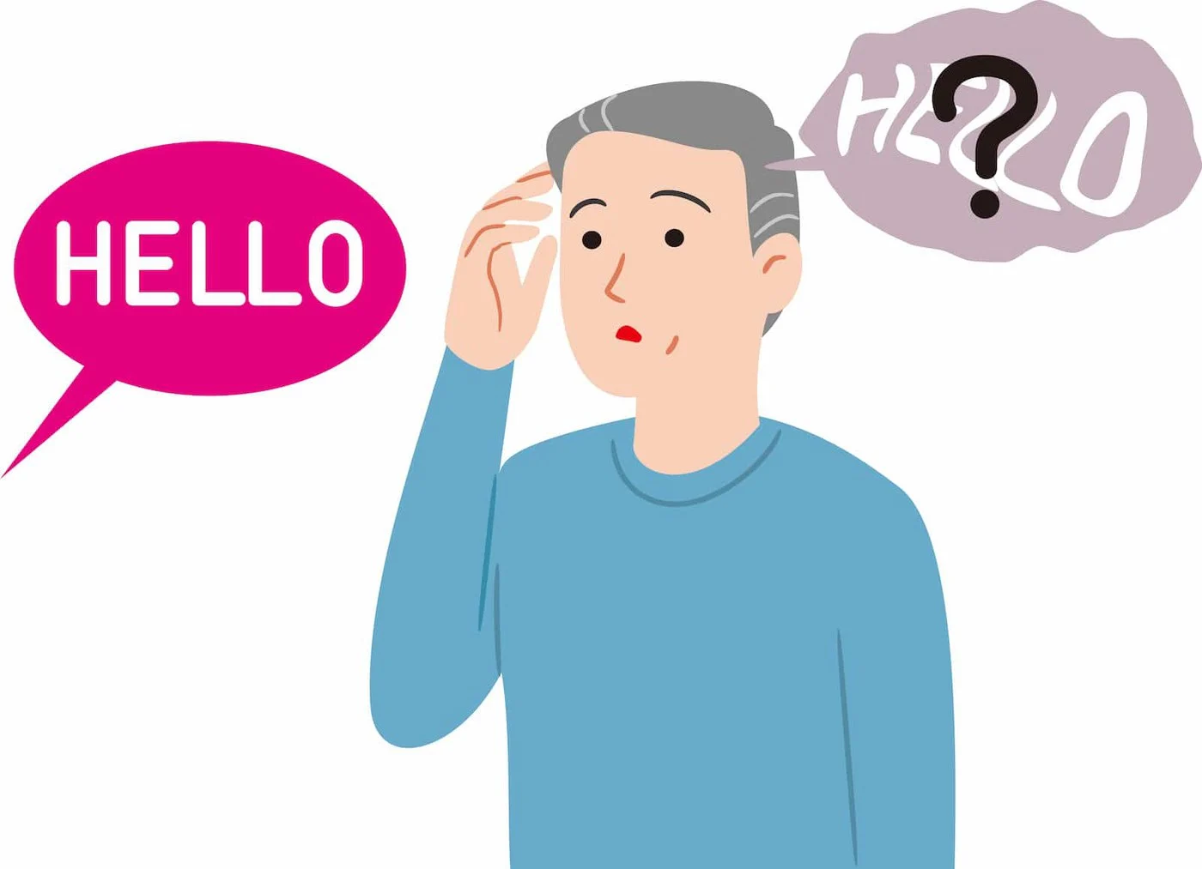
Neurological disorders affecting communication
Aphasia
Language disorder
Impairs the ability to understand and produce language, affecting speech, writing, reading, comprehension
Expressive (Broca’s aphasia): difficulty in speech production, preserved comprehension
Receptive (Wernicke’s aphasia): fluent but nonsensical speech and poor comprehension

Slide 35
Neurological disorders affecting communication
Dysarthria
Motor speech disorder caused by damage to the nerves or muscles involved in speech production
Can result from conditions such as stroke, brain injury, Parkinson's disease, or multiple sclerosis
Affects the clarity, strength, and coordination of speech movements
Leads to slurred or unintelligible speech

Slide 36
Neurological disorders affecting communication
Apraxia of speech
Impairs the ability to plan and execute the movements necessary for speech
Difficulty initiating speech sound or sequencing sounds correctly
Inconsistent speech errors, difficulties in sound production and distorted articulation

Slide 37
Neurological disorders affecting communication
Traumatic brain injury
Depending on the severity and location of the injury, can cause
Aphasia
Dysarthria
Cognitive impairments
Speech difficulties
Changes in social communication skills

Slide 38
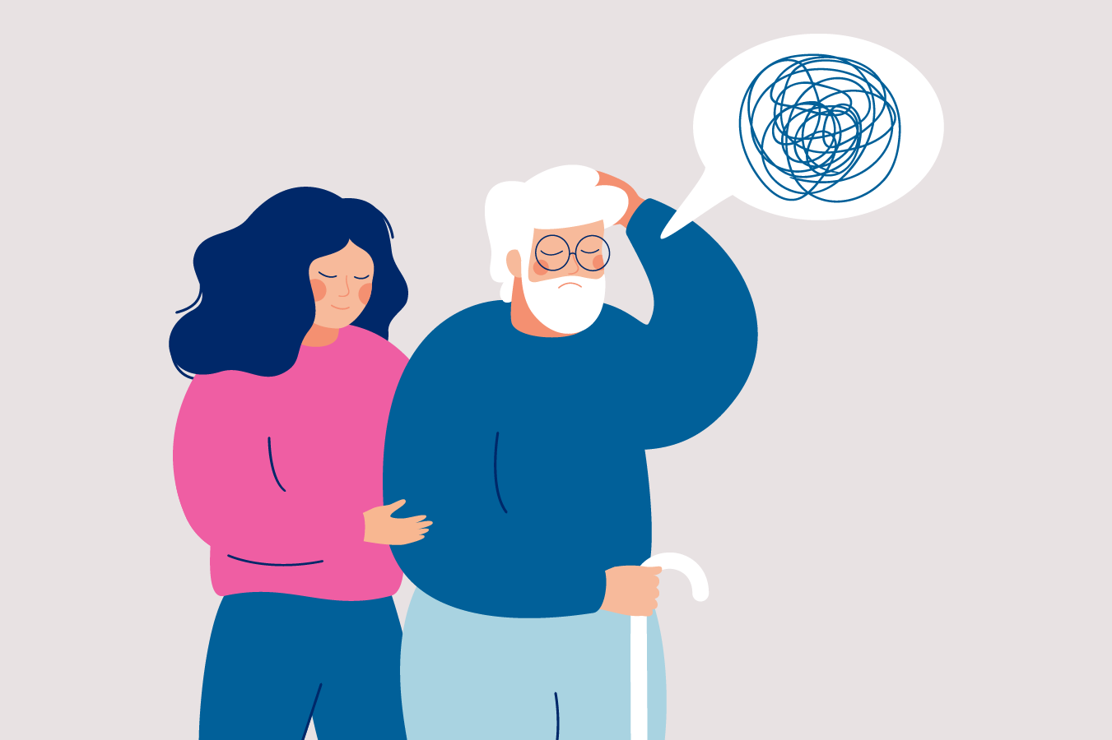
Neurological disorders affecting communication
Dementia
progressive decline in cognitive function caused by various conditions, such as Alzheimer's disease, vascular dementia, or Lewy body dementia
Word-finding problems
Can lead to confusion and difficulty understanding complex language

Slide 39
Developmental disorders affecting communication
Developmental disorders can significantly impact communication abilities, affecting various aspects of:
Language
Speech
Social interaction
Developmental disorders:
Autism Spectrum Disorder
Specific Language Impairment
ADHD
Specific Learning Disorders
Intellectual disability

Slide 40
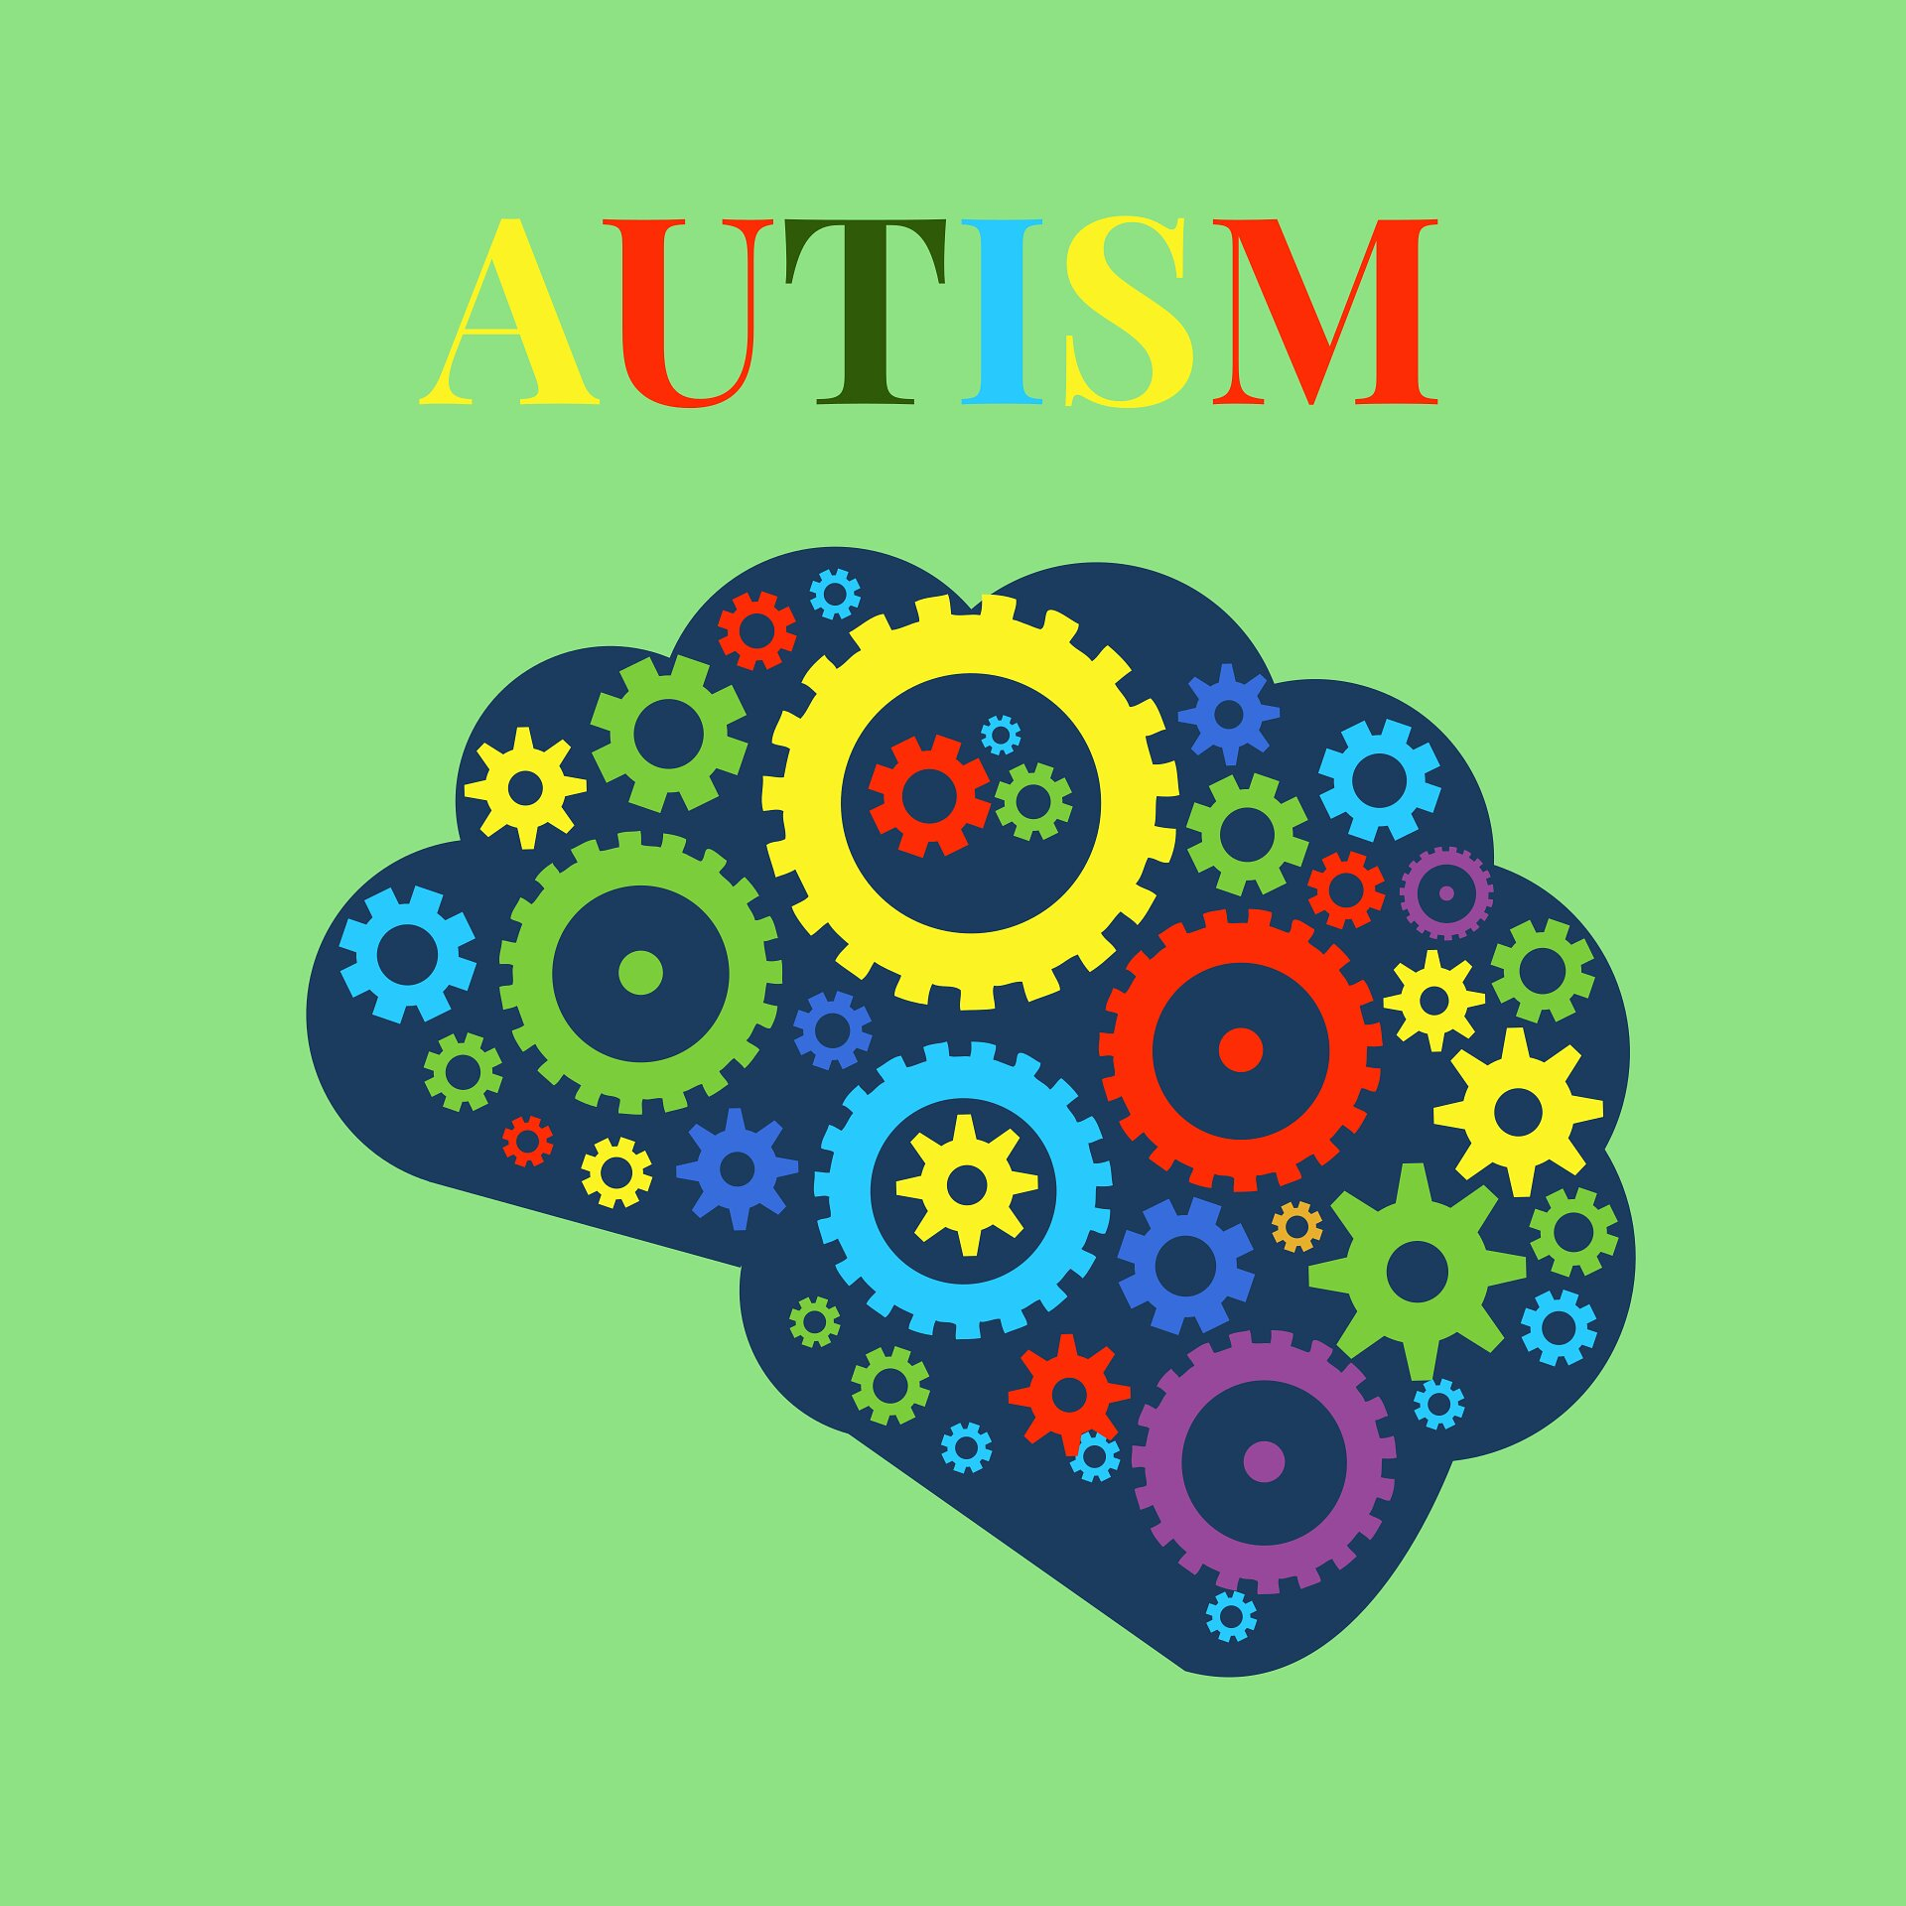
Developmental disorders affecting communication
Autism Spectrum Disorder
characterized by deficits in social communication and interaction, as well as restricted interests and repetitive behaviors.
Challenges with nonverbal communication (eye contact, gestures) and difficulty in understanding social cues and use of language in social contexts
Delayed language development
Echolalia

Slide 41
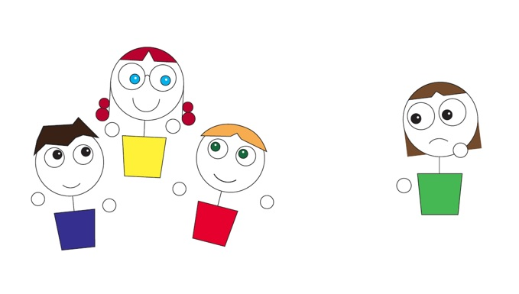
Developmental disorders affecting communication
Specific Language Impairment
Characterized by difficulties with language acquisition, despite typical cognitive development and absence of hearing or neurological impairments
Delayed speech and language milestones
Limited vocabulary
Grammar difficulties,
Challenges with comprehension and expression

Slide 42
Developmental disorders affecting communication
Attention Deficit Hyperactivity Disorder (ADHD)
Difficulty staying on topic
Interrupting others
Regulating social interactions
Maintaining attention during conversation
Following instructions
Organizing their thoughts
Misunderstanding in both academic and social settings

Slide 43
Developmental disorders affecting communication
Specific Learning Disorders
Reading (dyslexia)
Writing (dysgraphia)
Mathematics (dyscalculia)
Can impact language processing, written expression, and comprehension, affecting communication abilities in academic and everyday contexts

Slide 44
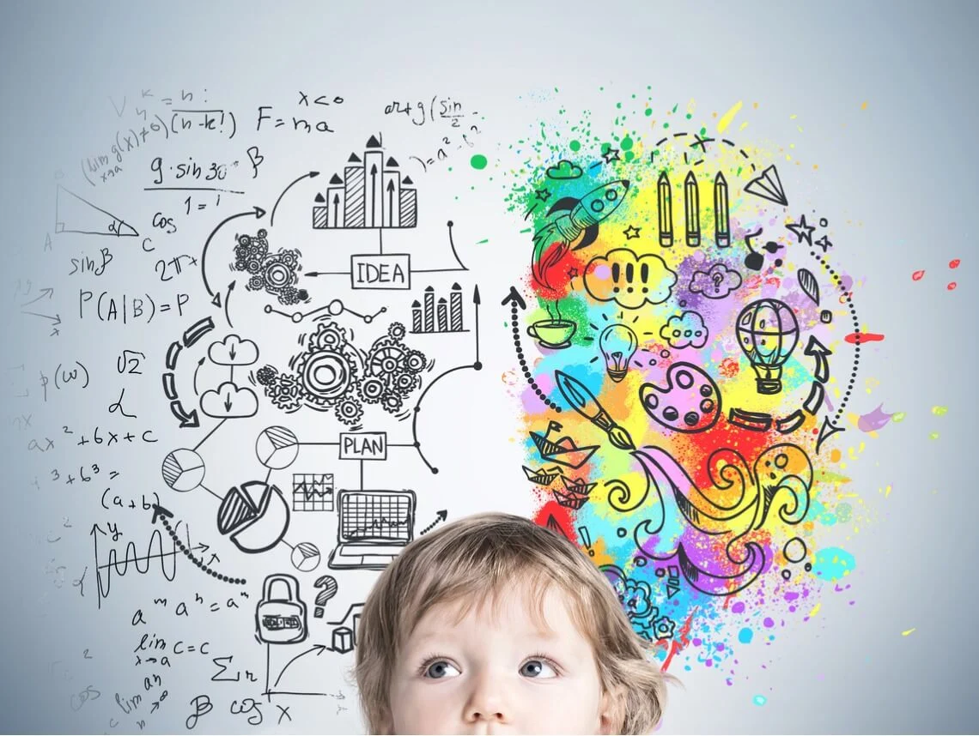
Developmental disorders affecting communication
Intellectual disability
significant limitations in intellectual functioning and adaptive behavior, which often impact communication abilities
Delayed language development
Limited vocabulary
Difficulty understanding abstract language concepts
Challenges with social communication skills

Slide 45
Psychological factors affecting communication
Psychological factors can significantly impact communication abilities, leading to difficulties in expressing thoughts and emotion, understanding social cues, and engaging in meaningful interactions with others. Individuals affected by these conditions may benefit from psychological interventions, or speech-language therapy.
Psychological factors:
Anxiety
Selective mutism
Depression
Social phobia
Stress

Slide 46
Psychological factors affecting communication
Anxiety disorders
Generalized anxiety disorder (GAD), social anxiety disorder (SAD), or panic disorder
Difficulty initiating or maintaining conversations, expressing themselves clearly, or engaging in public speaking due to fear of negative evaluation, embarrassment or nervousness
The speaker can have a rapid speech, stammering and sweating during conversation

Slide 47
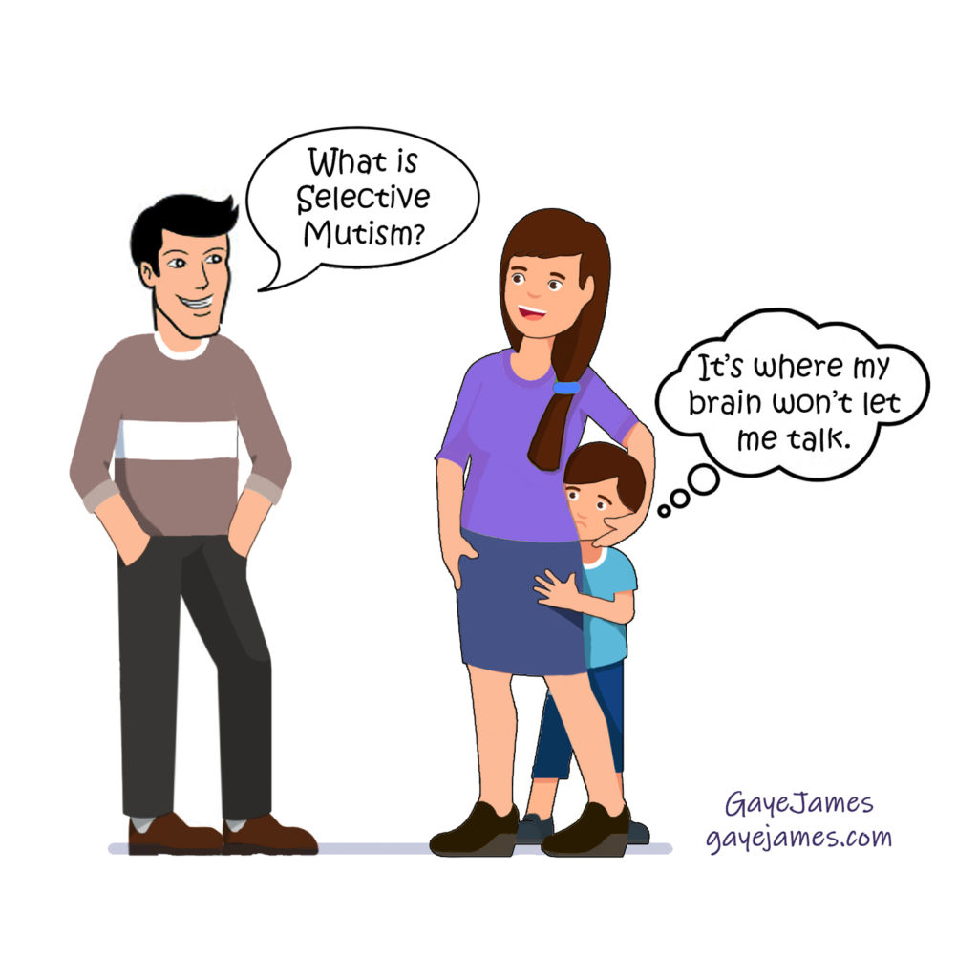
Psychological factors affecting communication
Selective mutism
Inability to speak in specific social situations (school, public places) despite being able to speak in other contexts
Children with selective mutism choose not to speak due to extreme shyness, anxiety, or fear of negative consequences

Slide 48
Psychological factors affecting communication
Depression
Affect communication by causing feelings of sadness, hopelessness, and low self-esteem
Difficulty expressing themselves
Conveying emotions
A monotone voice
Limited speech
Initiating and sustaining conversations

Slide 49
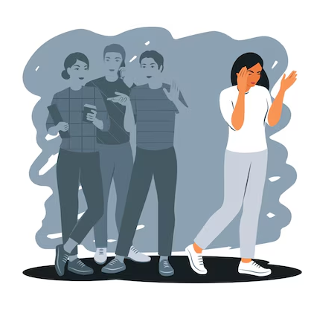
Psychological factors affecting communication
Social phobia
anxiety disorder characterized by intense fear or avoidance of social situations due to fear of negative evaluation or embarrassment.
Extreme anxiety in social settings, leading to avoidance of speaking or interacting with others, blushing, trembling, or difficulty maintaining eye contact

Slide 50
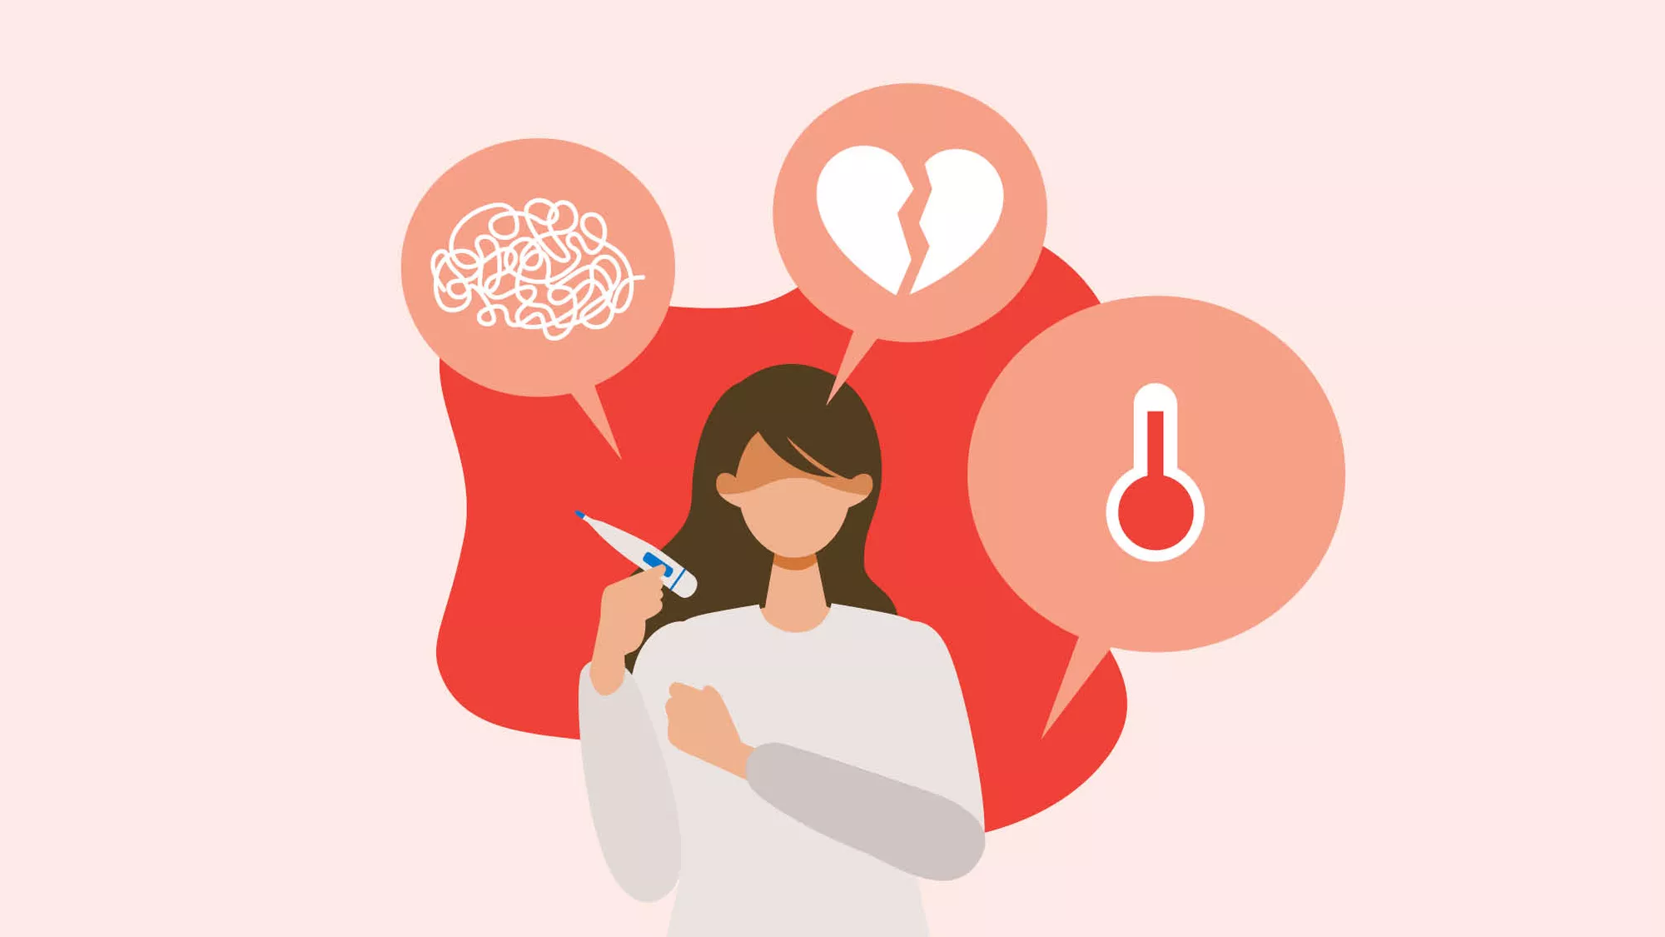
Psychological factors affecting communication
Stress
Can cause rushed speech, irritability, and difficulty in processing and responding information

Slide 51
Hearing and speech impairments
Hearing impairments
Affecting the ability to perceive and process auditory information effectively
Conductive hearing loss, sensorineural hearing loss, and mixed hearing loss
Conductive hearing loss
Difficulty hearing speech sounds clearly, especially in noisy environments
Struggle to understand conversations or follow verbal instructions due to reduced clarity and volume of incoming sounds

Slide 52
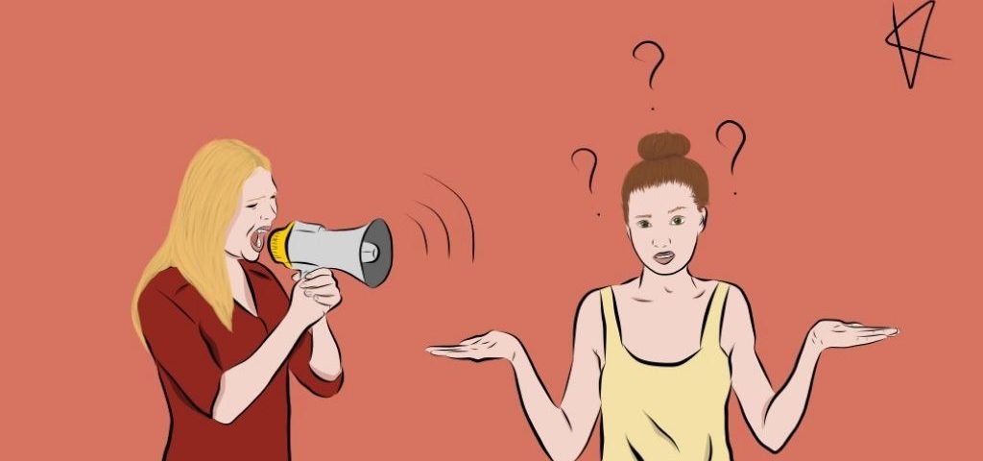
Hearing and speech impairments
Sensorineural hearing loss
Difficulty discriminating between speech sounds or understanding conversations, particularly in noisy environments
Mixed hearing loss
Difficulty hearing speech sounds, understanding conversations and following verbal instructions

Slide 53
Hearing and speech impairments
Speech disorders
Affect the production, articulation, fluency, or quality of speech
Stuttering, apraxia of speech, dysarthria, phonological, articulation and voice disorders
Stuttering
Disruptions in the flow of speech (fluency disorders), such as repetitions, prolongations, or blocks of sounds and syllables
It can cause anxiety about speaking and avoidance of communication

Slide 54
Hearing and speech impairments
Apraxia of speech
Difficulty planning and coordinating the movements needed for speech production
Inconsistent speech errors, difficulty initiating or sequencing speech sounds, and challenges with coordinating articulatory movements
Dysarthria

Slide 55
Hearing and speech impairments
Phonological disorders
Consistent patterns of sound substitutions, deletions, or distortions that affect intelligibility
Articulation disorders
Difficulty producing speech sounds accurately due to problems with the placement, timing, or coordination of movements of the lips, tongue, palate, or jaw
Voice disorders
Abnormalities in the quality, pitch, loudness, or resonance of the voice that impact communication

Slide 56
06
Conclusion and key points

Slide 57
Effective communication is vital for fostering meaningful connections, promoting collaboration, and achieving mutual goals in personal, professional, and societal contexts. By understanding the principles, processes, and challenges of communication, individuals can enhance their communication skills and navigate interpersonal interactions more effectively.

Slide 58
Thank you for your attention!
Project no: 2022-1-RO01-KA220-VET-000085029

